Slide 1


Huazhong University of Science and Technology
The Department of Electronics and Information Engineering
Electronic Circuit Analysis and Design
Dr. Tianping Deng
Email: dengtp@hust.edu.cn

Slide 2
Contents
PART 1 SEMICONDUCTOR DEVICES AND BASIC APPLICATIONS
Chapter 1 Semiconductor Materials and Diodes
Chapter 2 Diode Circuits
Chapter 3 The Field-Effect Transistor
Chapter 4 Basic FET Amplifiers
Chapter 5 The Bipolar Junction Transistor
Chapter 6 Basic BJT Amplifiers
Chapter 7 Frequency Response
Chapter 8 Output Stages and Power Amplifiers
PART 2 ANALOG ELECTRONICS
Chapter 9 Ideal Operational Amplifiers and Op-Amp Circuits
Chapter 10 Integrated Circuit Biasing and Active Loads
Chapter 11 Differential and Multistage Amplifiers
Chapter 12 Feedback and Stability
Chapter 13 Operational Amplifier Circuits
Chapter 14 Nonideal Effects in Operational Amplifier Circuits
Chapter 15 Applications and Design of Integrated Circuits

Slide 3
Review
Op-amp(ch9,13,14)
Structure
Model
Device
Diode(ch1,2)
Principles
Features
FET(chap3,4)
Characteristics
designing techniques
BJT(ch5,6)
Parameters
BJT,FET amplifiers
Graphical
Principles
Power amp(ch8)
Small-Signal
Circuit
Diff-amp(chap11)
Instantaneous polarities
Features
Feedback(ch12)
Op-amp circuit(ch9)
AC, DC
Filters, oscillators(ch15)
Virtual short
Virtual open
voltage regulator(ch15)
Signal
Sine，etc.

Slide 4
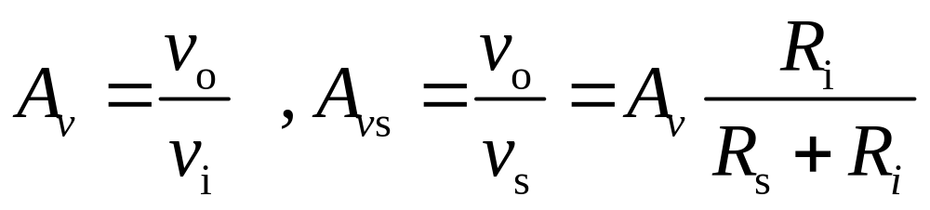
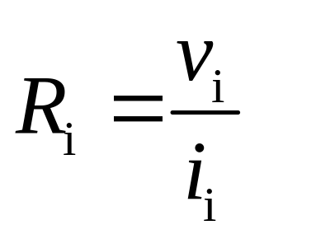
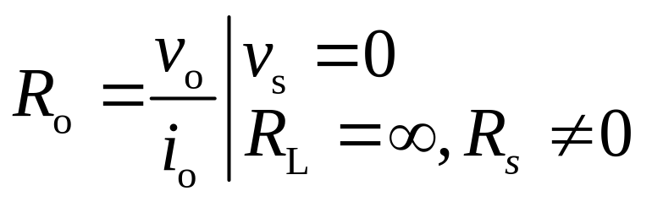
Most important

Slide 5
Diode
Semiconductor
n_{i}＝p_{i}
Intrinsic
Extrinsic
N-type
P-type
PN junction
Diodes
Forward Biasing
Reverse Biasing
Rectifier
Zener

Slide 6
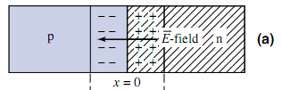
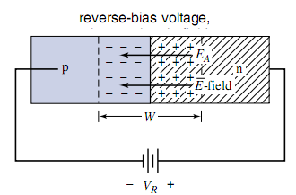
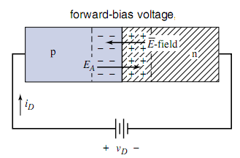
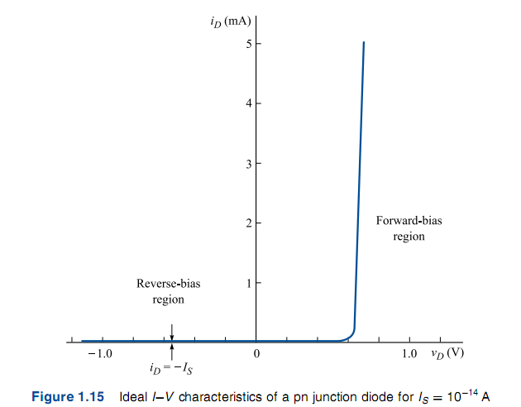

Diode

Slide 7
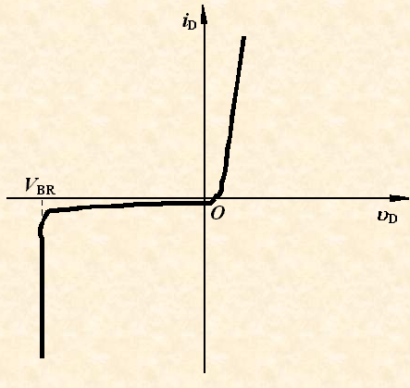
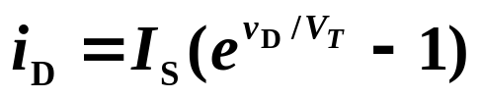
Diode
Majority carriers
Diffusion
PN Junction
Minority carriers
Drift
Rectifier Circuits
Clipper and Clamper Circuits
Multiple-Diode Circuits

Slide 8
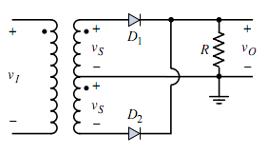
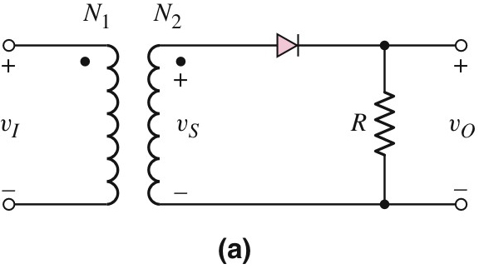
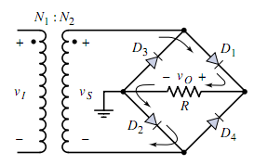
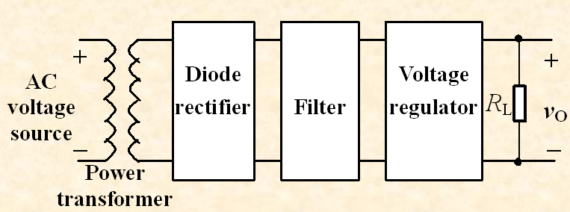
Rectifier

Slide 9
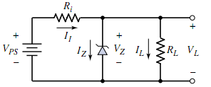
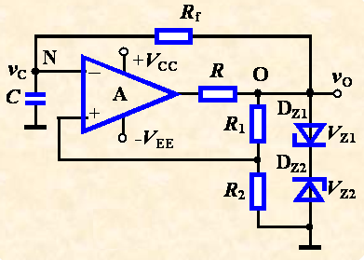
Zener Diode

Slide 10
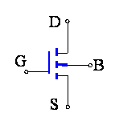
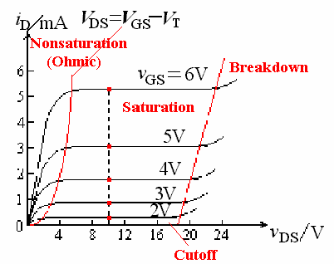
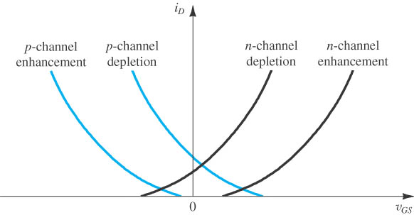
Overview
For chapter 3 and chapter 4:
1、MOSFET structure，feature, i-v characteristic

Slide 11
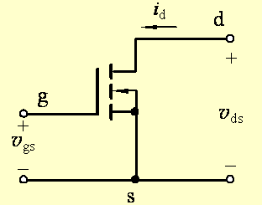
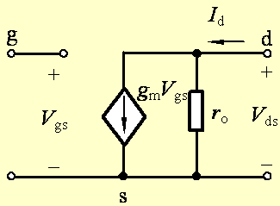
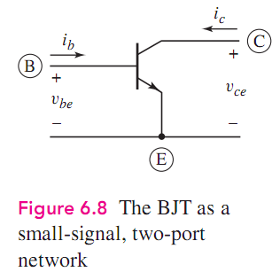
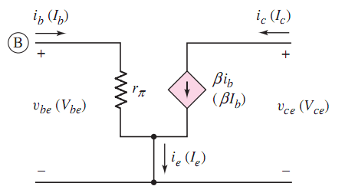

Slide 12
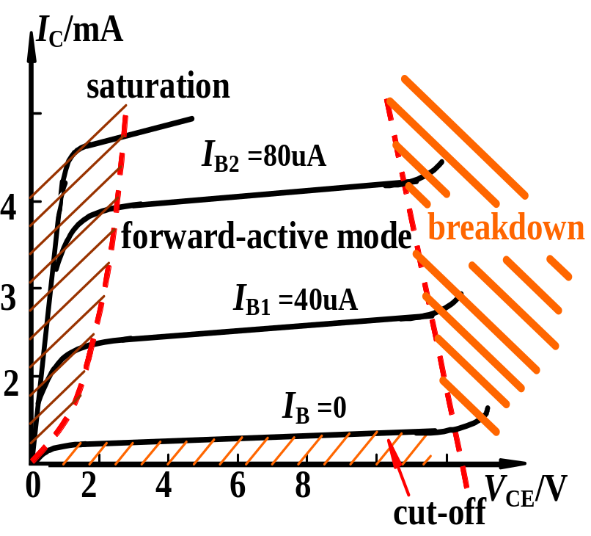
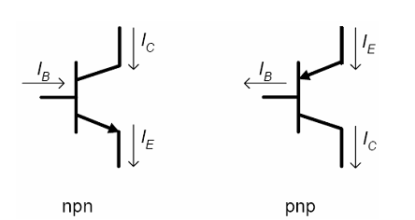
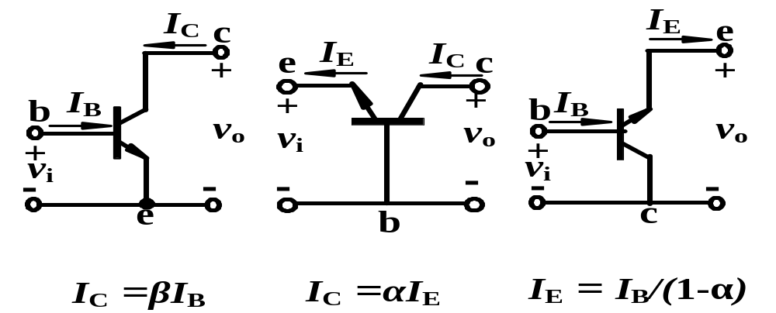
BJT
BJT Circuit Configurations

Slide 13

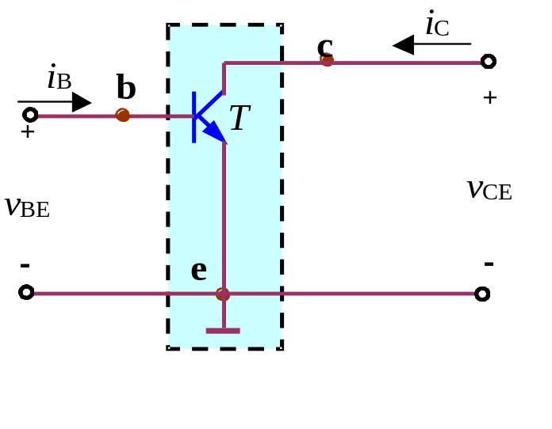
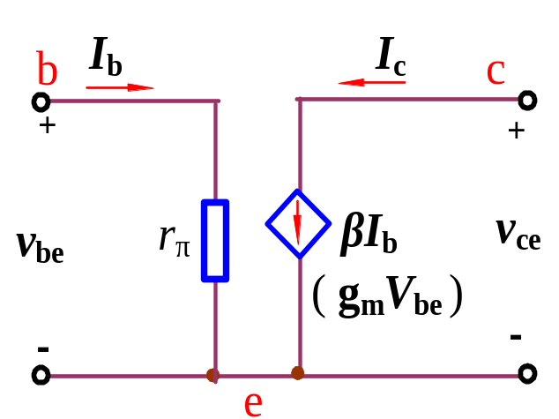
BJT
DC Analysis
Q-point
AC Analysis
Small signal model

Slide 14
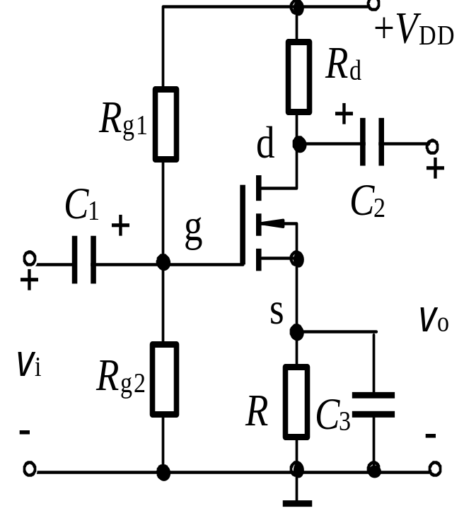
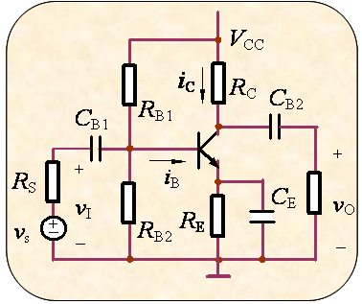
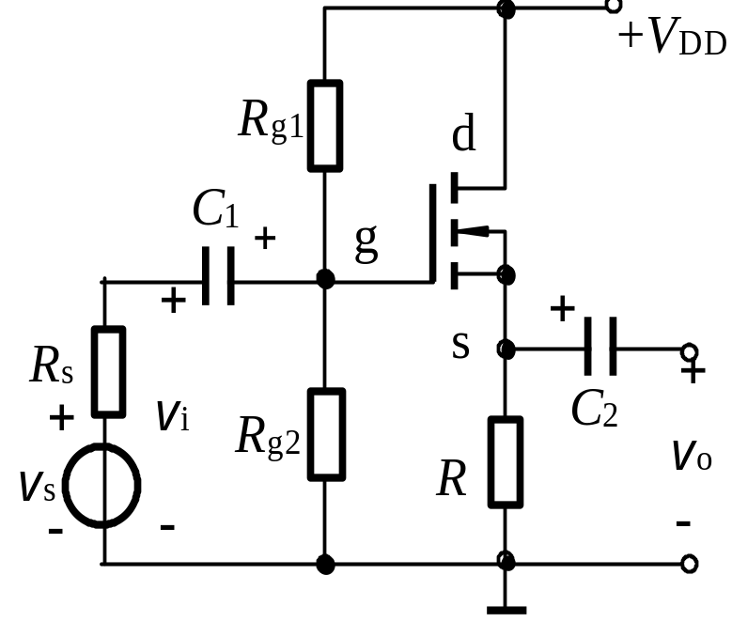
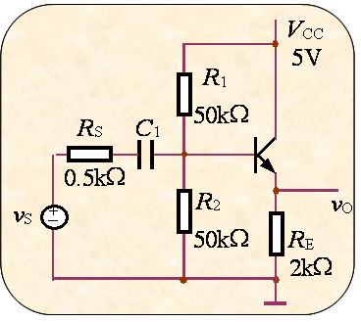
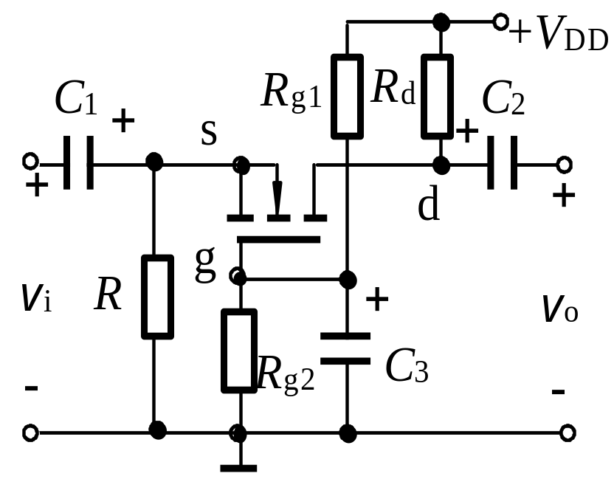
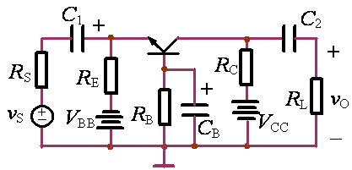
CH3&4 5&6
BJT
FET
CE
CS
Inverting Amplifier
CC
CD
voltage follower
CB
CG
current follower

Slide 15
DC Analysis
Q－point
DC biasing

Slide 16
AC Analysis
A_{V}，R_{i}，R_{o}
AC Performance

Slide 17
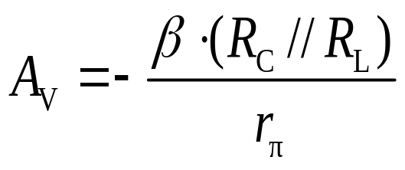
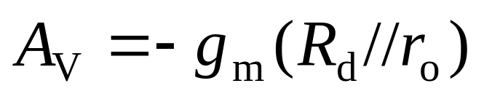
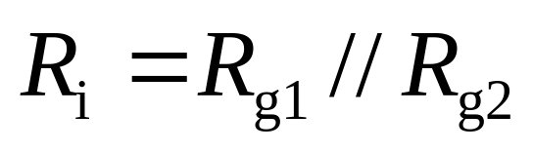
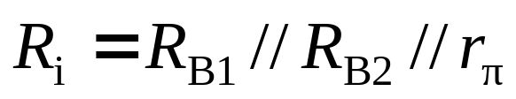
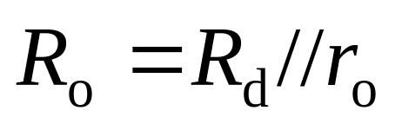
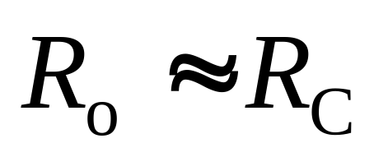
The Three Basic Amplifier Configuration:

Slide 18
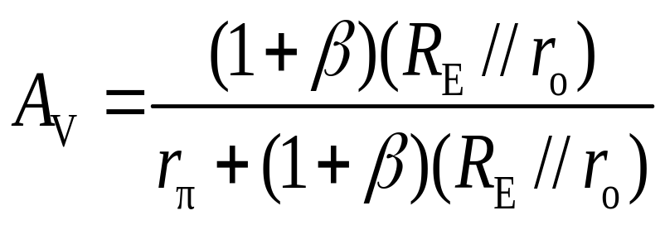
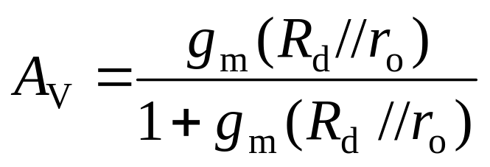
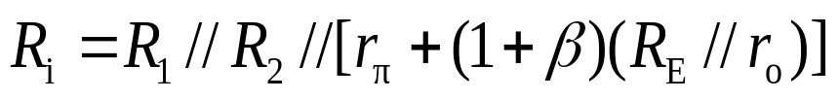
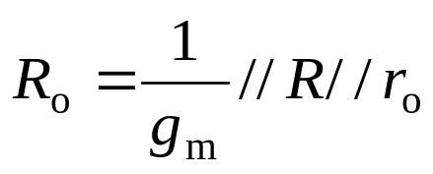
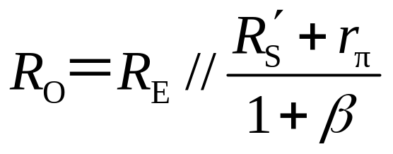
The Three Basic Amplifier Configuration:

Slide 19
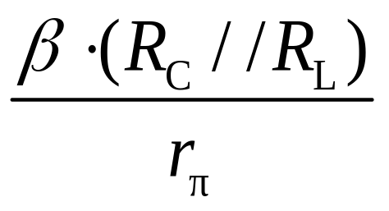
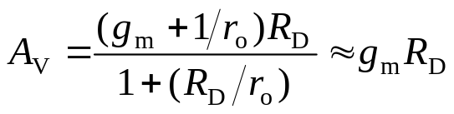
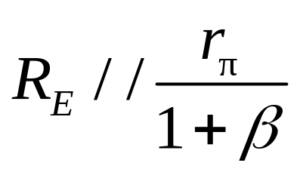
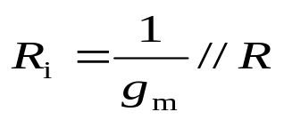
The Three Basic Amplifier Configuration:

Slide 20
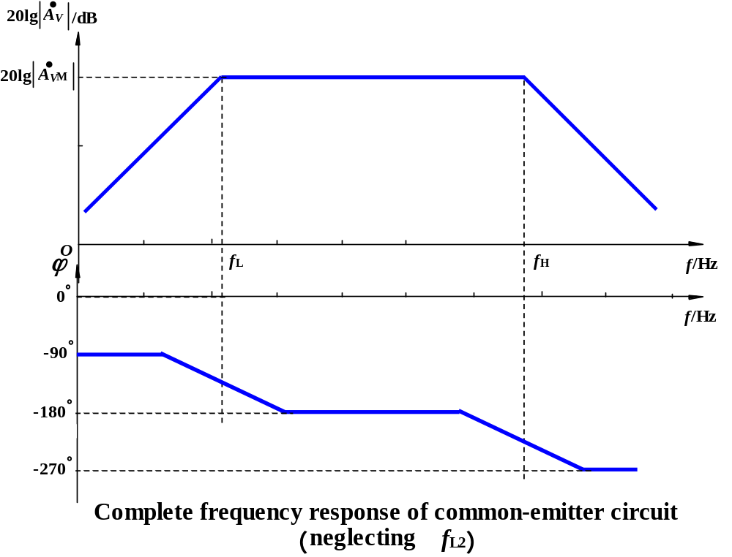
Complete Frequency Response of Common-Emitter

Slide 21
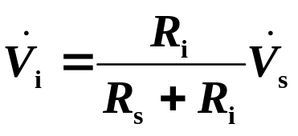





Loading effect
Voltage amplifier
Current amplifier

Slide 22


Voltage amplifier
Current amplifier

Slide 23


Slide 24





Slide 25


Slide 26
Op-Amp Circuits
Inverting Amplifier
Summing Amplifier
Noninverting Amplifier
Difference Amplifier
Integrator
Differentiator

Slide 28
Most important
1、Discrete device circuits (MOSFET, Differential
DC –Q-point
Small-signal model equivalent circuit
AC A_{V}, R_{i}, R_{o},
Distortion
Frequency response (basic concept)

Slide 29
Most important
2、Feedback circuit
Feedback Configuration
Feedback improving performance parameters
Analysis of Feedback Circuits
3、 additional applications and designs of amp
active filters,
oscillators
voltage regulator

Slide 30


Slide 31








Input stages—R_{i}↑
Middle stage—A_{V} ↑
output—R_{o} ↓
CC、CE
CE、CB
CC
R_{i}↑
2 signals subtract
DC coupled
R_{L} very small
MOSFET
Differential
Current
source
Power amplifier
improving performance
additional applications and designs
Op-amp
Feedback

Slide 32












Op-amp

Slide 33






Exercises
5. Design feedback network,
determine its parameter, and
connect it with basic amp.
Assume that closed-loop is
(+)
(-)
(-)
(-)
Shunt-Shunt

Slide 34

Sketch Voltage Transfer Characteristic

Slide 35


Slide 36


Slide 37



Slide 38
PART 1 SEMICONDUCTOR DEVICES AND BASIC APPLICATIONS
Chapter 1 Semiconductor Materials and Diodes
Chapter 2 Diode Circuits
Chapter 3 The Field-Effect Transistor
Chapter 4 Basic FET Amplifiers
Chapter 5 The Bipolar Junction Transistor
Chapter 6 Basic BJT Amplifiers
Chapter 7 Frequency Response
Chapter 8 Output Stages and Power Amplifiers
PART 2 ANALOG ELECTRONICS
Chapter 9 Ideal Operational Amplifiers and Op-Amp Circuits
Chapter 10 Integrated Circuit Biasing and Active Loads
Chapter 11 Differential and Multistage Amplifiers
Chapter 12 Feedback and Stability
Chapter 13 Operational Amplifier Circuits
Chapter 14 Nonideal Effects in Operational Amplifier Circuits
Chapter 15 Applications and Design of Integrated Circuits

Slide 39
Q & A Time
Carefully
Wish all of you success !

Slide 40
Questions
and
Answers

